Slide 1
GRADE 7 ACCELERATED · UNIT 4 · LESSONS 7–8
Real-World Order of Operations
MA.8.NSO.1.7
I can substitute values into a formula and evaluate it, reading what the situation does rather than hunting for key words.
Grade 7 Accelerated · Unit 4 · Lessons 7–8 — Real-World Order of Operations
1

Slide 2
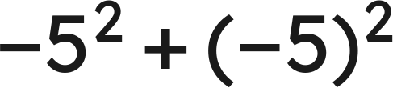
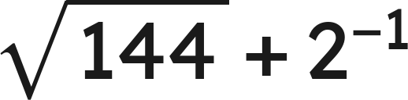
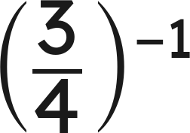


Warm-Up
1.
2.
3. Find the value:
4. Evaluate
when
.
Grade 7 Accelerated · Unit 4 · Lessons 7–8 — Real-World Order of Operations
2

Slide 3
Warm-Up
1.
0
2.
25/2
3. Find the value:
4/3
4. Evaluate
when
.
18
Grade 7 Accelerated · Unit 4 · Lessons 7–8 — Real-World Order of Operations
3

Slide 4



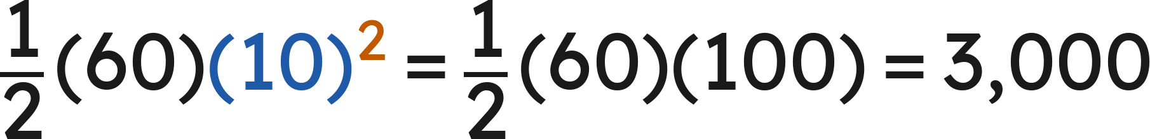



Notes
I. Substituting: the value goes in parentheses
with
and
:
joules
with
:
, never
Substitute in parentheses, then evaluate by the structure — powers before products.
Grade 7 Accelerated · Unit 4 · Lessons 7–8 — Real-World Order of Operations
4

Slide 5
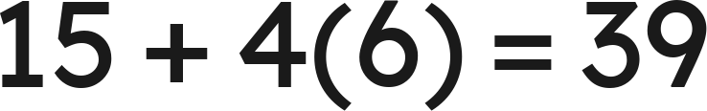

Notes
II. Key words do not decide the operation
15 dollars plus 4 dollars for each of 6 gigabytes:
15 dollars for each of 4 lines, plus 6 dollars of tax:
The same words, the same numbers, different structures. Read the situation.
Grade 7 Accelerated · Unit 4 · Lessons 7–8 — Real-World Order of Operations
5

Slide 6
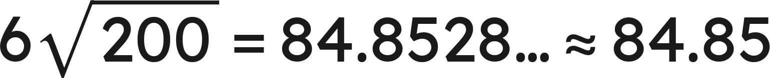

Notes
III. Round once, at the end — and say the unit
feet
rounding the side to 14 first:
feet
Carry the exact value, round once at the end, and write the unit.
Grade 7 Accelerated · Unit 4 · Lessons 7–8 — Real-World Order of Operations
6

Slide 7




Example 1
Kinetic energy is
,
for mass
in kilograms and speed
in meters per second.
Find
for a car of mass 1,200 kg travelling at 15 m/s.
Give the answer with its unit.
Grade 7 Accelerated · Unit 4 · Lessons 7–8 — Real-World Order of Operations
7

Slide 8
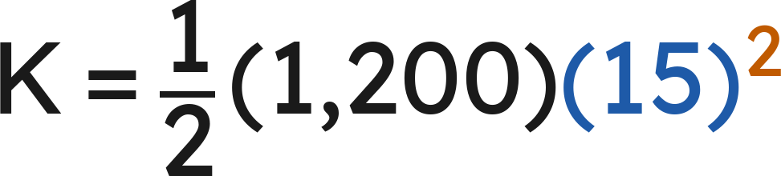
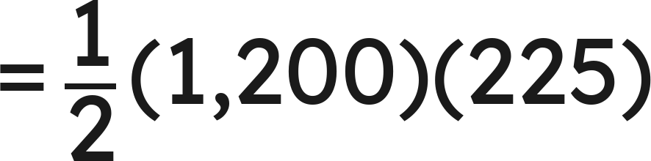
Example 1
Answer: 135,000 joules
Grade 7 Accelerated · Unit 4 · Lessons 7–8 — Real-World Order of Operations
8

Slide 9



Your Turn
Find
for
kg and
m/s.
Grade 7 Accelerated · Unit 4 · Lessons 7–8 — Real-World Order of Operations
9

Slide 10




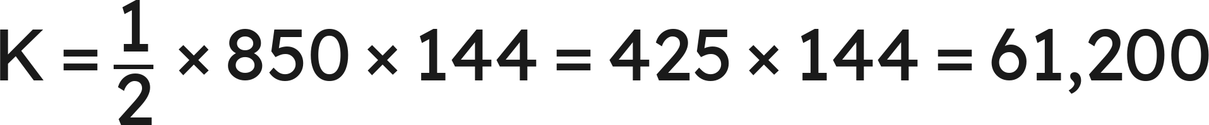
Your Turn
Find
for
kg and
m/s.
Answer: 61,200 joules
Grade 7 Accelerated · Unit 4 · Lessons 7–8 — Real-World Order of Operations
10

Slide 11
Example 2
A square floor of side 9 feet is carpeted.
Carpet is 2.89 dollars a square foot and padding is 0.75 dollars a square foot.
Installation is a flat 95 dollars. Find the total cost.
Grade 7 Accelerated · Unit 4 · Lessons 7–8 — Real-World Order of Operations
11

Slide 12

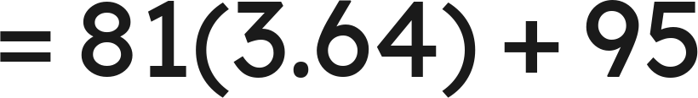
Example 2
Answer: 389.84 dollars
Grade 7 Accelerated · Unit 4 · Lessons 7–8 — Real-World Order of Operations
12

Slide 13
Your Turn
A square bathroom floor of side 6 feet is tiled.
Tile is 4.25 dollars a square foot and grout is a flat 13.48 dollars.
Find the total cost.
Grade 7 Accelerated · Unit 4 · Lessons 7–8 — Real-World Order of Operations
13

Slide 14


Your Turn
A square bathroom floor of side 6 feet is tiled.
Tile is 4.25 dollars a square foot and grout is a flat 13.48 dollars.
Find the total cost.
Area:
Tile:
Total:
Answer: 166.48 dollars
Grade 7 Accelerated · Unit 4 · Lessons 7–8 — Real-World Order of Operations
14

Slide 15


Whiteboards · Question 1 of 9
Evaluate
when
.
Answer it.
Grade 7 Accelerated · Unit 4 · Lessons 7–8 — Real-World Order of Operations
15

Slide 16


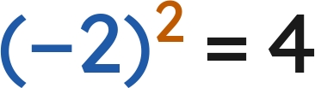

Whiteboards · Question 1 of 9
Evaluate
when
.
Answer: 12
Grade 7 Accelerated · Unit 4 · Lessons 7–8 — Real-World Order of Operations
16

Slide 17
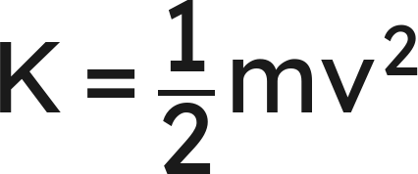


Whiteboards · Question 2 of 9
A cyclist has a mass of 70 kilograms and rides at 8 meters per second.
Her bicycle cost 480 dollars.
Kinetic energy is
, for a mass
and a speed
.
Find her kinetic energy.
Answer it.
Grade 7 Accelerated · Unit 4 · Lessons 7–8 — Real-World Order of Operations
17

Slide 18

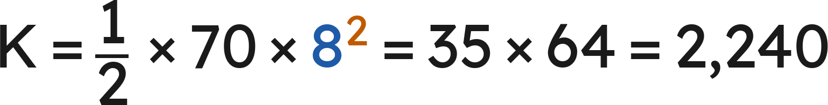
Whiteboards · Question 2 of 9
A cyclist has a mass of 70 kilograms and rides at 8 meters per second.
Her bicycle cost 480 dollars.
Kinetic energy is
, for a mass
and a speed
.
Find her kinetic energy.
Answer: 2,240 joules
Grade 7 Accelerated · Unit 4 · Lessons 7–8 — Real-World Order of Operations
18

Slide 19
Whiteboards · Question 3 of 9
Renting a kayak costs 17 dollars plus 9 dollars for each hour.
Find the cost of 3 hours.
Answer it.
Grade 7 Accelerated · Unit 4 · Lessons 7–8 — Real-World Order of Operations
19

Slide 20


Whiteboards · Question 3 of 9
Renting a kayak costs 17 dollars plus 9 dollars for each hour.
Find the cost of 3 hours.
Answer: 44 dollars
Grade 7 Accelerated · Unit 4 · Lessons 7–8 — Real-World Order of Operations
20

Slide 21
Whiteboards · Question 4 of 9
A square floor of side 8 feet is tiled at 3.50 dollars a square foot.
Installation is a flat 60 dollars.
Find the total cost.
Answer it.
Grade 7 Accelerated · Unit 4 · Lessons 7–8 — Real-World Order of Operations
21

Slide 22



Whiteboards · Question 4 of 9
A square floor of side 8 feet is tiled at 3.50 dollars a square foot.
Installation is a flat 60 dollars.
Find the total cost.
Area:
Tile:
Total:
Answer: 284 dollars
Grade 7 Accelerated · Unit 4 · Lessons 7–8 — Real-World Order of Operations
22

Slide 23



Whiteboards · Question 5 of 9
Evaluate
when
and
.
Which is the value?
A. 180
B. 120
C. 360
D. 3,600
Answer it.
Grade 7 Accelerated · Unit 4 · Lessons 7–8 — Real-World Order of Operations
23

Slide 24



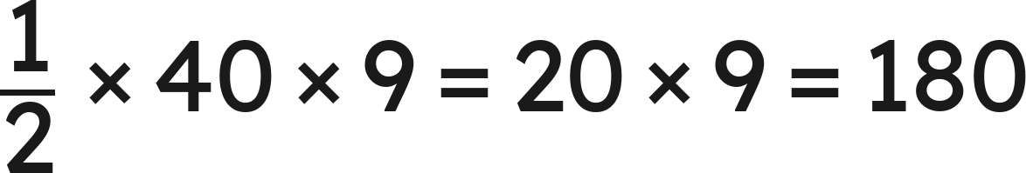
Whiteboards · Question 5 of 9
Evaluate
when
and
.
Which is the value?
Answer: A — 180
Grade 7 Accelerated · Unit 4 · Lessons 7–8 — Real-World Order of Operations
24

Slide 25
Whiteboards · Question 6 of 9
A square patio of side 12 feet is sealed at 1.25 dollars a square foot.
Delivery of the sealer is a flat 38 dollars.
Which expression gives the total cost?
A. 12(1.25) + 38
B. 12² + 1.25 + 38
C. 12²(1.25 + 38)
D. 12²(1.25) + 38
Answer it.
Grade 7 Accelerated · Unit 4 · Lessons 7–8 — Real-World Order of Operations
25

Slide 26



Whiteboards · Question 6 of 9
A square patio of side 12 feet is sealed at 1.25 dollars a square foot.
Delivery of the sealer is a flat 38 dollars.
Which expression gives the total cost?
Area
square feet, at 1.25 dollars each:
The 38 dollars is added once:
Answer: D — 12²(1.25) + 38
Grade 7 Accelerated · Unit 4 · Lessons 7–8 — Real-World Order of Operations
26

Slide 27
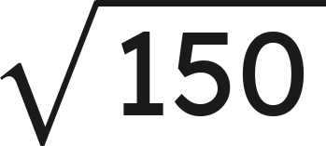
Whiteboards · Question 7 of 9
A square garden has 4 sides, each
feet long.
Find its perimeter, to the nearest hundredth of a foot.
Answer it.
Grade 7 Accelerated · Unit 4 · Lessons 7–8 — Real-World Order of Operations
27

Slide 28
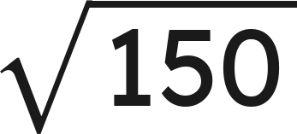
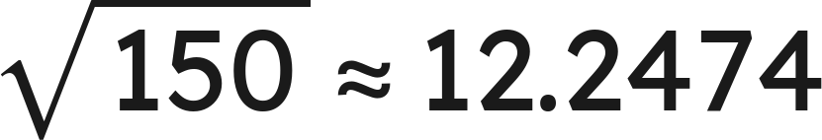
Whiteboards · Question 7 of 9
A square garden has 4 sides, each
feet long.
Find its perimeter, to the nearest hundredth of a foot.
Answer: 48.99 feet
Grade 7 Accelerated · Unit 4 · Lessons 7–8 — Real-World Order of Operations
28

Slide 29
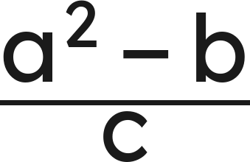



Whiteboards · Question 8 of 9
Evaluate
when
,
,
.
Answer it.
Grade 7 Accelerated · Unit 4 · Lessons 7–8 — Real-World Order of Operations
29

Slide 30
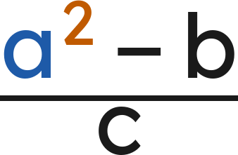




Whiteboards · Question 8 of 9
Evaluate
when
,
,
.
Top:
Answer: 9
Grade 7 Accelerated · Unit 4 · Lessons 7–8 — Real-World Order of Operations
30

Slide 31
Whiteboards · Question 9 of 9
One pizza order costs 13 dollars plus 2 dollars for each of 5 toppings.
Another costs 13 dollars for each of 2 pizzas, plus 5 dollars for delivery.
Find both totals, and say why the key words could not have told you.
Write your answer in sentences.
Grade 7 Accelerated · Unit 4 · Lessons 7–8 — Real-World Order of Operations
31

Slide 32
Whiteboards · Question 9 of 9
One pizza order costs 13 dollars plus 2 dollars for each of 5 toppings.
Another costs 13 dollars for each of 2 pizzas, plus 5 dollars for delivery.
Find both totals, and say why the key words could not have told you.
First order:
Second order:
Both say "plus" and "for each". What repeats is different.
Answer: 23 dollars and 31 dollars
Grade 7 Accelerated · Unit 4 · Lessons 7–8 — Real-World Order of Operations
32

Slide 33


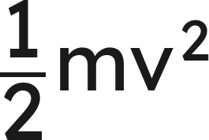






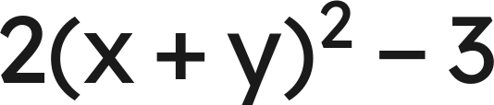


Independent Set
1.
when
2.
when
and
3.
when
,
,
4.
A square room of side 10 feet is carpeted at 2.65 dollars a square
foot, with a flat 55 dollars for fitting. Find the total cost.
5.
when
and
6.
A gym charges 25 dollars to join plus 8 dollars for each of 6 classes.
Find the total cost.
Grade 7 Accelerated · Unit 4 · Lessons 7–8 — Real-World Order of Operations
33

Slide 34
IXL
1.
Open IXL and start today's skills.
2.
Work on paper where the question needs work. The answer box does not show it.
3.
Every skill listed is required, to a SmartScore of 67. Due at the start of the next class.
Today's skills — all required
Evaluate variable expressions: word problems — DPG
Grade 7 Accelerated · Unit 4 · Lessons 7–8 — Real-World Order of Operations
34

